Slide 2
What Is COVID: The Effect On Youth?
COVID: The Effect on Youth is an alternative to the Medway Youth Council's annual conference which has 3 key stages.
It is looking at how the pandemic has impacted young people’s mental wellbeing and their futures.
This presentation details the headline results. The Medway Youth Council will produce a report which will be made available to everyone to access which discusses the findings of “COVID: The Effect on Youth”.

Slide 3
The 3 Stages:

Slide 4
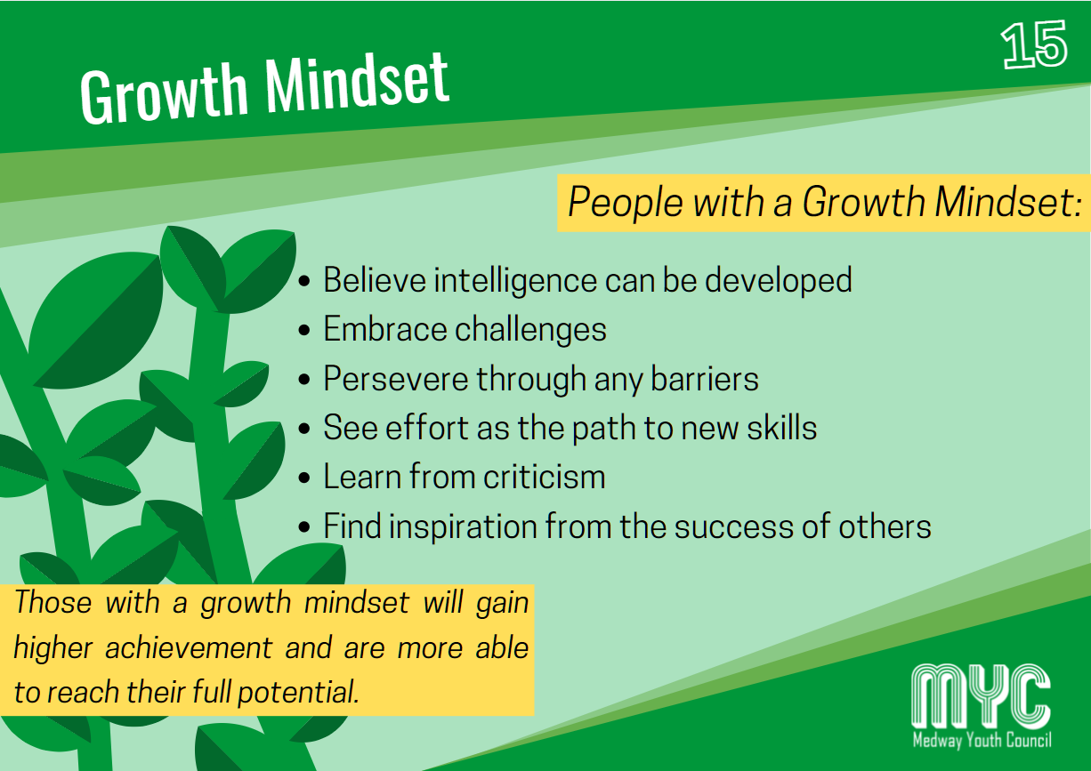
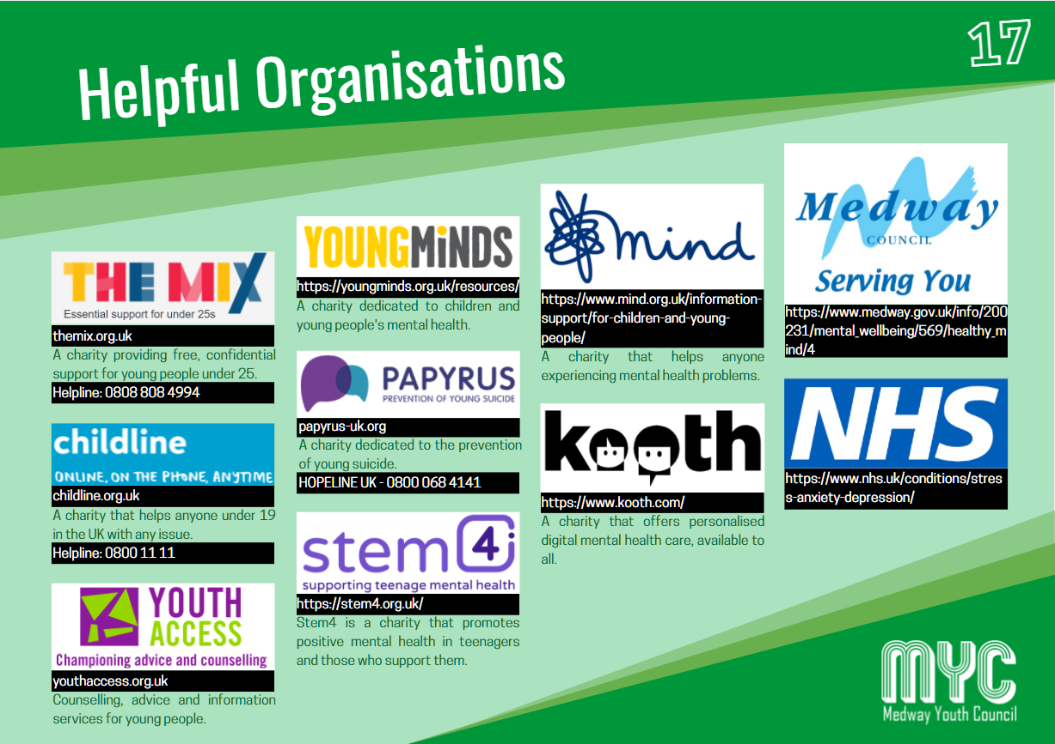
The Mental Wellbeing support pack
The Medway Youth Council created a mental wellbeing support pack which was distributed to Young People across Medway. It was developed to help assist Young People with their mental wellbeing and to signpost organisations where they can receive support from. Alongside the mental wellbeing pack, the Medway Youth Council produced online content and promoted services that Young People can use.
To download the mental wellbeing pack please go to: https://www.medwayyouthcouncil.co.uk/covid-the-effect-on-youth

Slide 5
How Was The Survey Conducted?
The “COVID: The Effect on Youth” survey was an anonymous virtual survey conducted through Google forms collecting two pieces of personal information (year of school and start of postcode).
This was distributed to Young People throughout Medway, mainly through schools and social media. The survey opened on the 20th of March and closed on the 21st of April receiving a total of 396 responses.

Slide 6
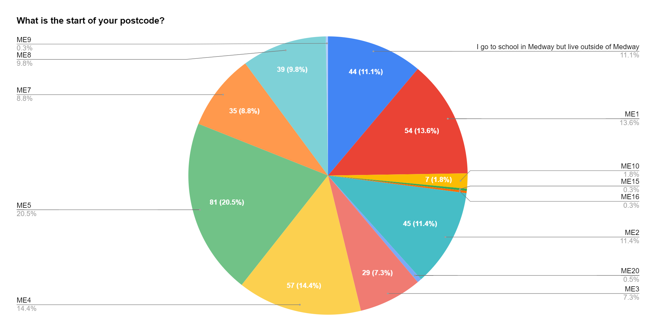
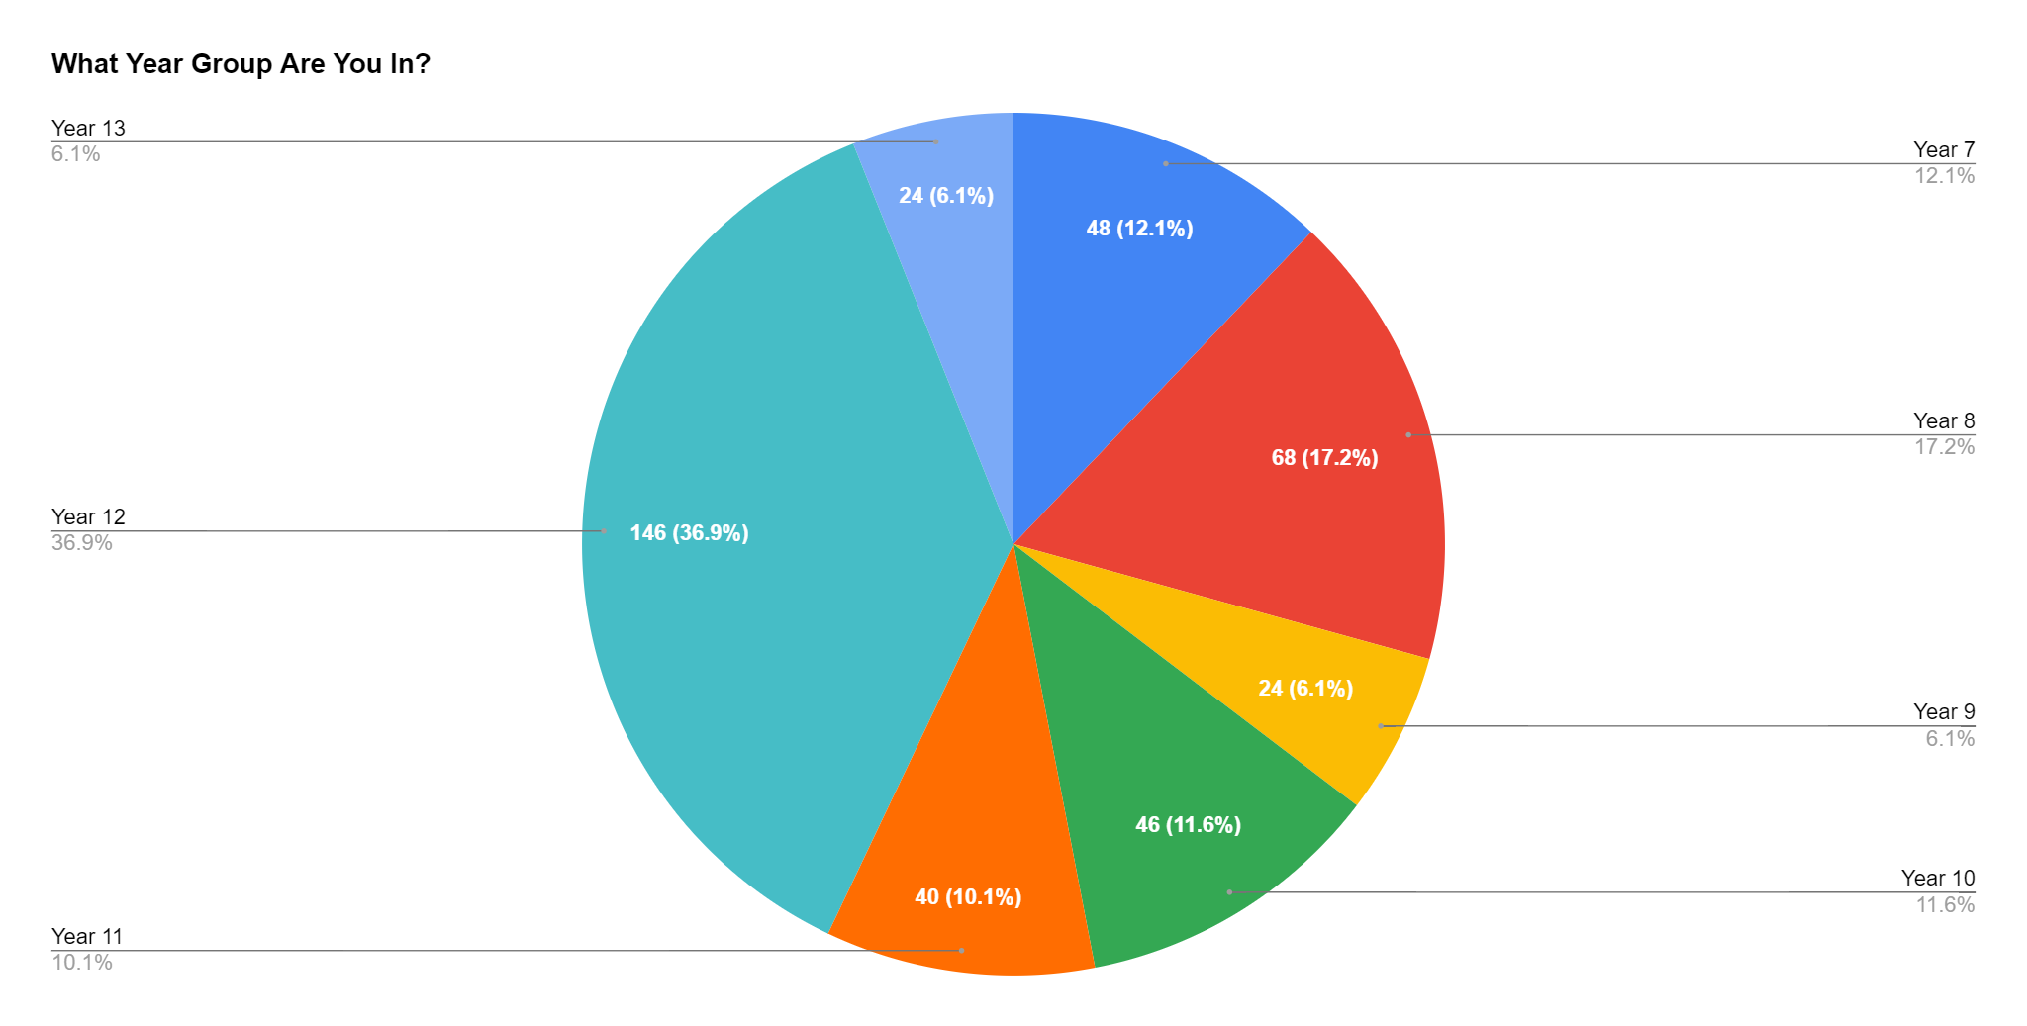
Postcode & Year Group Distribution

Slide 7
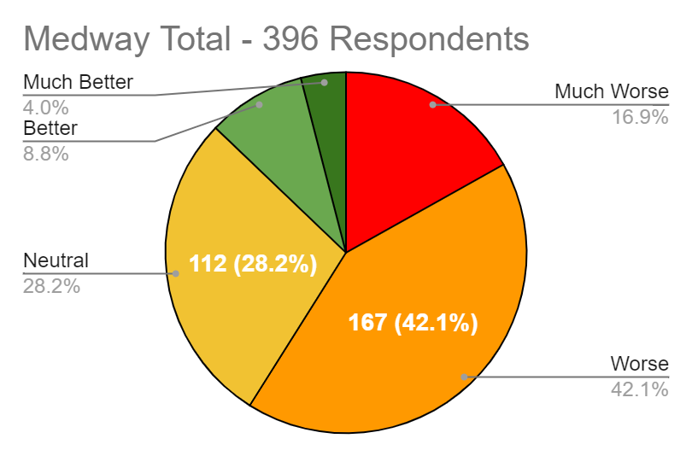
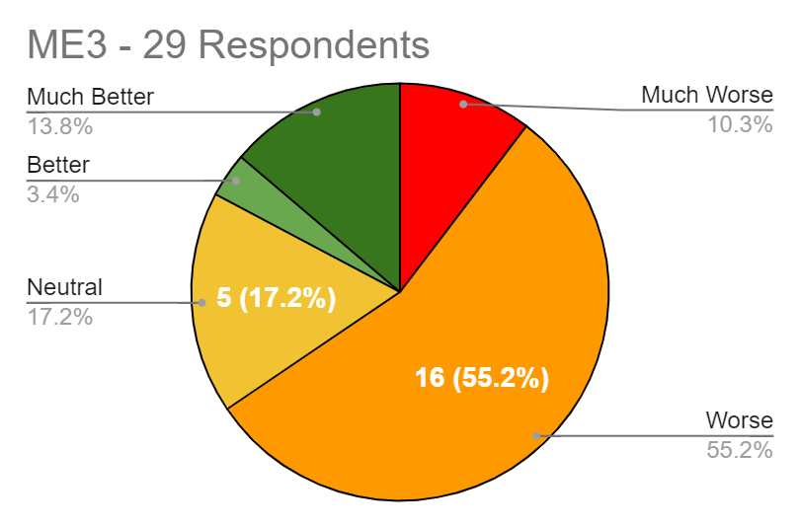
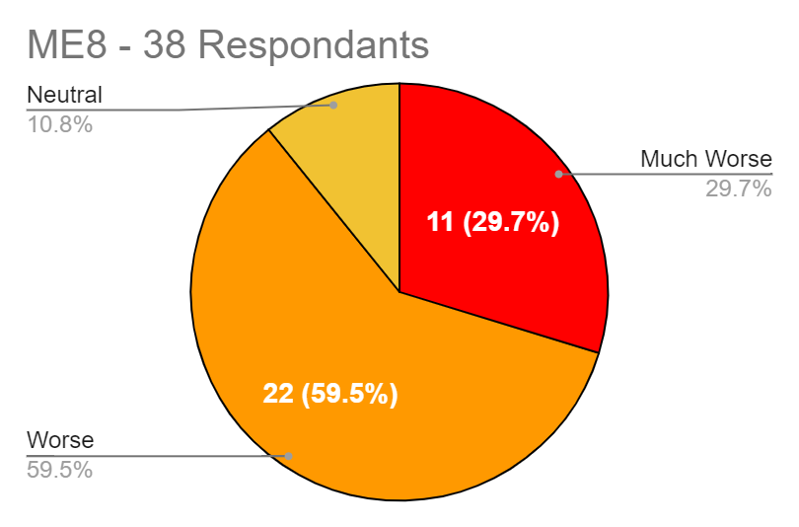
How Has Your Mental Wellbeing Been Affected By The Pandemic?
Young people’s recommendations
Exercise, meeting new people online, talking to friends, limiting exposure to social media, creative activity, finding new hobbies, Kooth and therapy if appropriate.
Causes of worsening mental wellbeing
Confusion over exams
Lack of social interaction
Family issues (Death, Divorce, Greater responsibilities)
New insecurities (Eating disorders, social anxiety)
Causes of improved mental wellbeing
Extra free time for hobbies
More family time
Self reflection/extra time to think about future

Slide 8
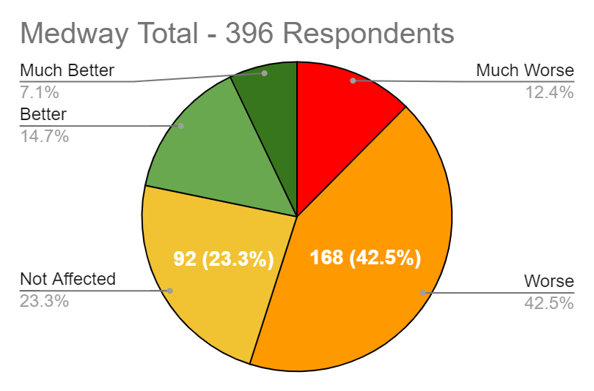
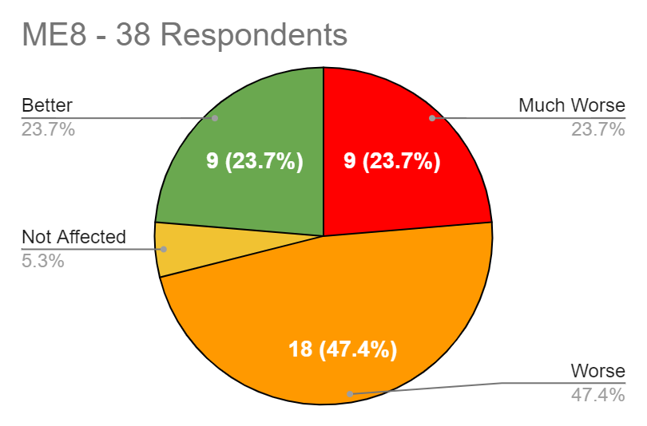
How Has Your Mental Wellbeing Been Affected By The Closure Of Schools?
Causes of improved mental wellbeing
Teachers checking in on students
Seeing family more
Greater sleep and free time
Screen breaks in lessons
Regular walks/exercise
Working at your own pace (greater independence)
Being able to listen to music
Causes of worsening mental wellbeing
Uncertainty surrounding grades
People felt teaching was uncompassionate (too much work, strict, mock exams schedules not being flexible)
Missing social contact/friends
Harder to get any mental wellbeing support needed

Slide 9
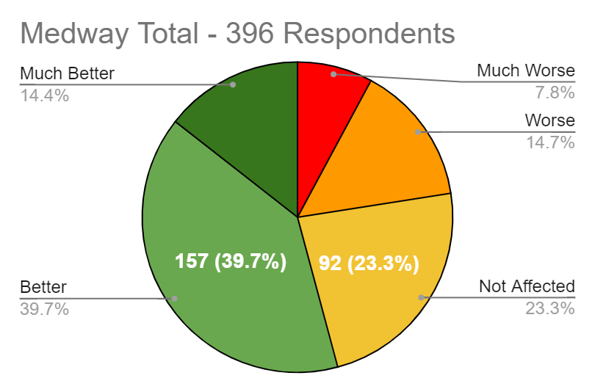
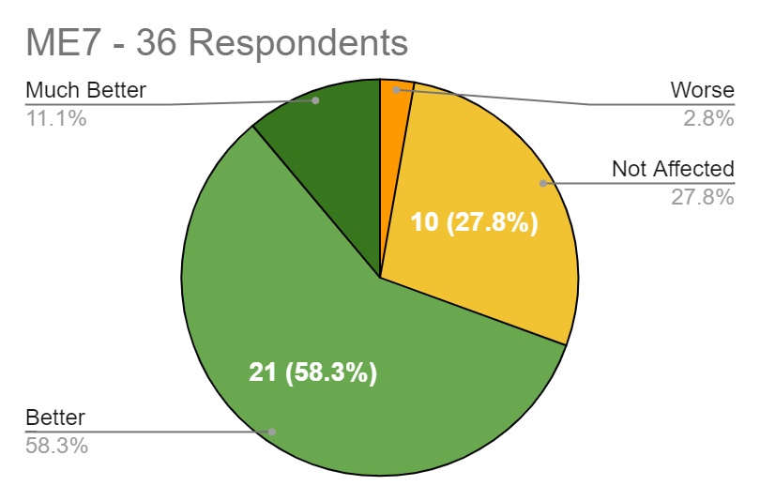
How has your Mental wellbeing been affected by the return of schools?
Causes of improved mental wellbeing
Being more productive
Seeing friends/teachers in person
A more structured routine
Subjects like Drama, Art, Physical education resuming
Less uncertainty
Causes of worsening mental wellbeing
Reduced sleep and free time
Academic struggles
Face masks which can be distracting
Fear of COVID
Social struggles (interactions with other people)

Slide 10
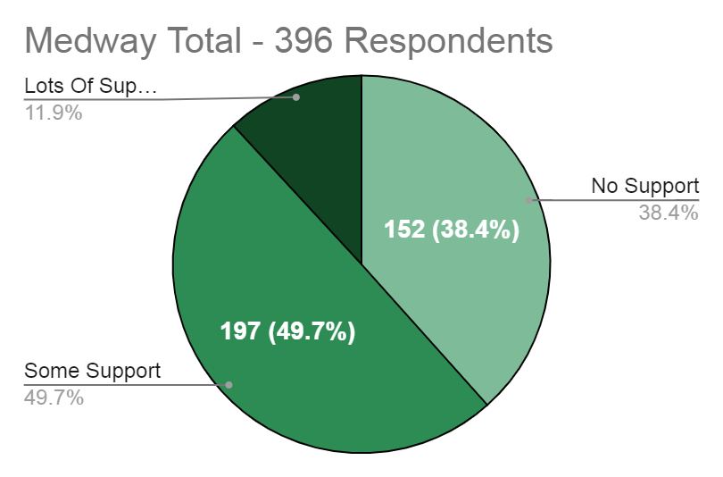
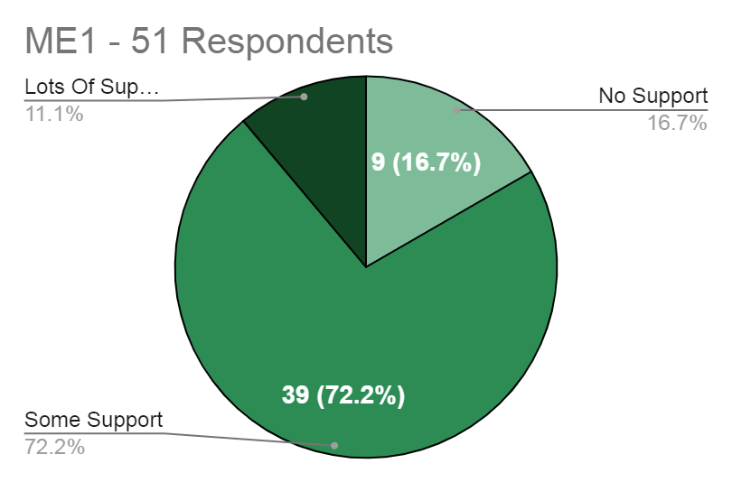
Have You Had Access To Mental Wellbeing Support During The Pandemic?
Mental Wellbeing Support Used By Young People During The Pandemic
Headspace | Support from teachers and school
Therapy | Kooth
Personalised school checkups | Counselling
Childline/NSPCC | NHS
Talking to friends and family | CAMHS
Mental Wellbeing Support Young People Want
Greater support for those with mental health disorders wanted
Help with meeting new people and socialising

Slide 11
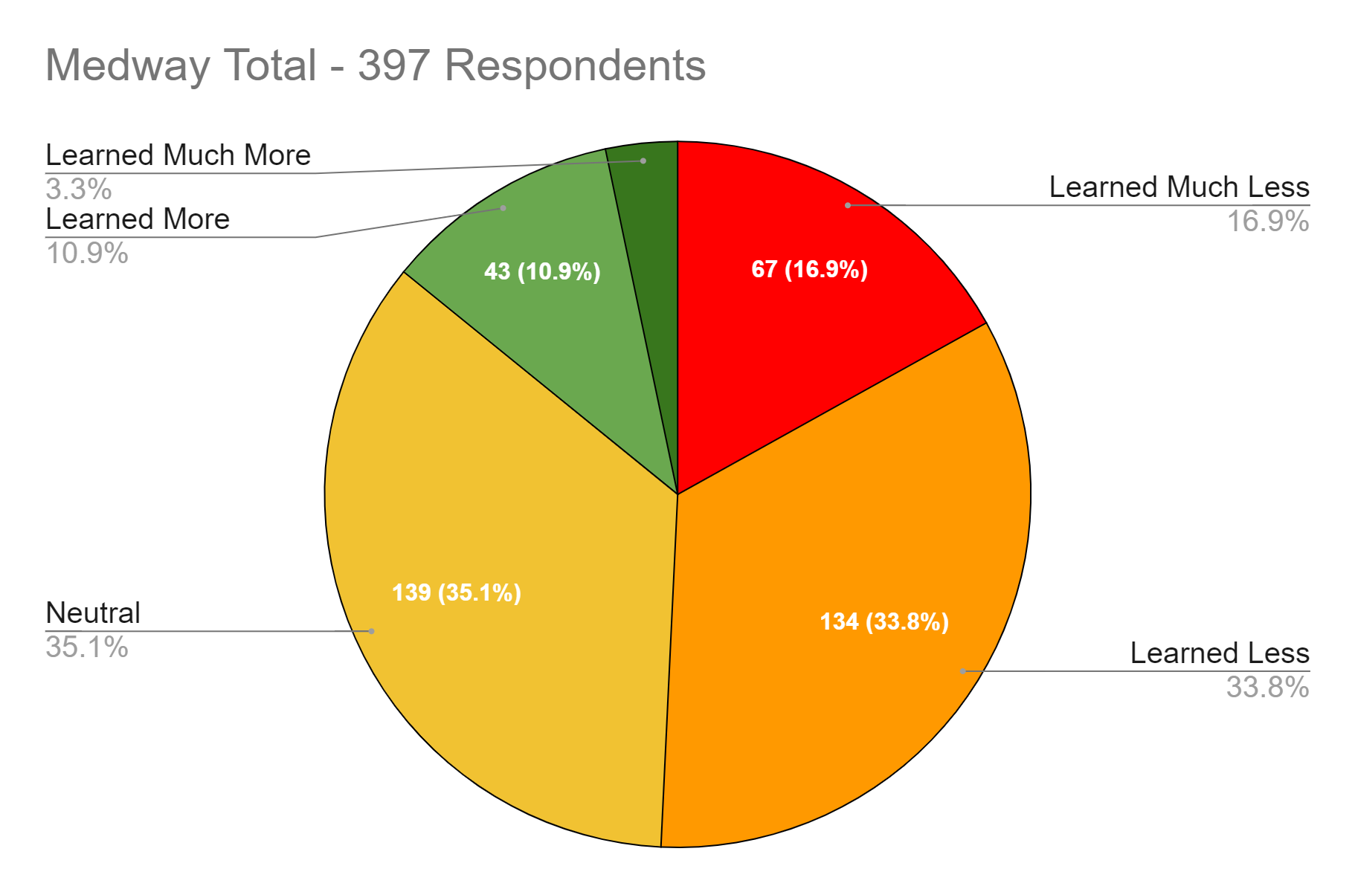
How much more or less have you learnt during the online learning period?
Positives of online learning
More comfortable learning environment
Greater independence
More sleep
Higher level of organisation
Greater access to tools online
Gave students time for reflection
More time for family
Lesser costs (no traveling, school meals)
Negatives of online learning
Easier to become distracted
Many felt they learnt considerably less
Hard to manage workload
Lower teaching quality due to reduced feedback and attention
Hard or impossible to do practical subjects like PE, DT, Art
Struggling to always access online lessons due to technical difficulties (WiFi)
Headaches, migraines and sore eyes among other symptoms from prolonged screen exposure

Slide 12
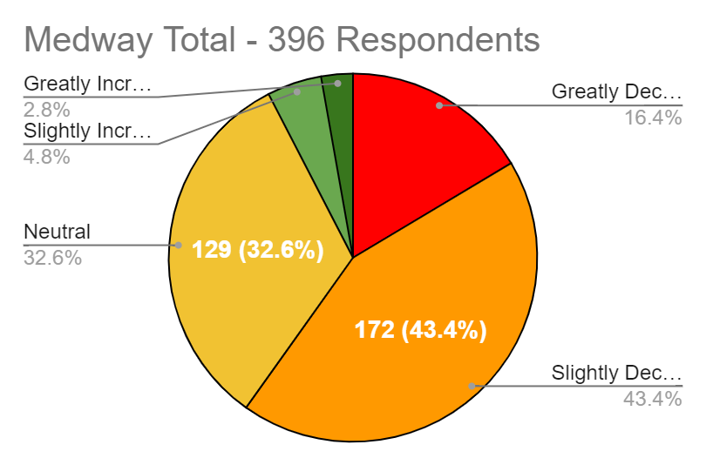
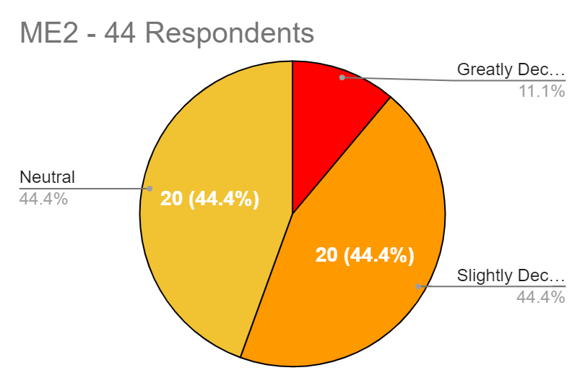
How Do You Feel Your Future Oppourtunities Have Been Affected By The Pandemic?
Reasons for greater opportunities
More time to think about the future
Improved work ethic as a result of independence
Online opportunities
Reasons for fewer opportunities
Missed out on learning and learning time
Not studying as hard due to lack of motivation
Missing out on key life skills
Worried about getting lower grades
Missing out on opportunities after school such as work, apprenticeships, universities, volunteering, summer school

Slide 13
What should continue post pandemic?
What Should Continue Post Pandemic?
Things students wish to continue after pandemic
Greater mental health and well being awareness
Cleanliness and increase in general hygiene
Recording lessons
Use of Microsoft Teams as a platform
Using computers more actively

